Slide 1
MODULE-4
BCSE306
Artificial Intelligence
Dr.Priyanka N
Assistant Professor Senior Grade-1
School of Computer Science and Engineering (SCOPE),
VIT Vellore,
Priyanka.n@vit.ac.in

Slide 2
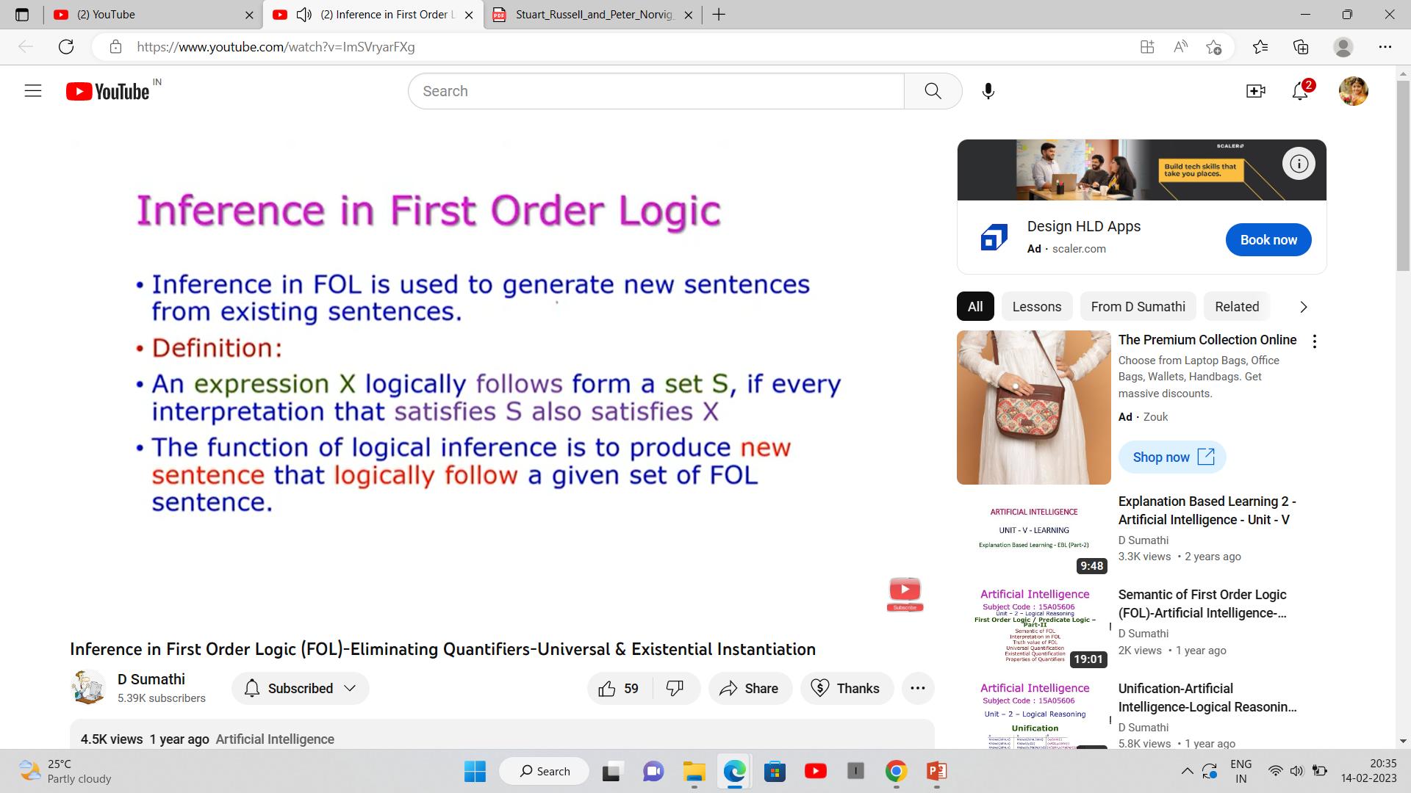

Slide 3
Basic terminologies used in FOL
1)Substitution
Substitution is a fundamental operation performed on terms and formulas.
It occurs in all inference systems in first-order logic.
The substitution is complex in the presence of quantifiers in FOL.
If we write F[a/x], so it refers to substitute a constant "a" in place of variable "x".

Slide 4
2) Equality
First-Order logic does not only use predicate and terms for making atomic sentences but also uses another way, which is equality in FOL.
For this, we can use equality symbols which specify that the two terms refer to the same object.
Example: Brother (John) = Smith.
As in the above example, the object referred by the Brother (John) is similar to the object referred by Smith. The equality symbol can also be used with negation to represent that two terms are not the same objects.
Example: ￢(x=y) which is equivalent to x ≠y.

Slide 5
FOL inference rules for quantifier
As propositional logic we also have inference rules in first-order logic, so following are some basic inference rules in FOL:
      Universal Generalization
      Universal Instantiation
      Existential Instantiation
      Existential introduction

Slide 6

1. Universal Generalization
Universal generalization is a valid inference rule that states that if premise P(c) is true for any arbitrary element c in the universe of discourse, then we can have a conclusion as ∀x P(x).
It can be represented as:
This rule can be used if we want to show that every element has a similar property.
In this rule, x must not appear as a free variable.
Example: Let's represent, P(c): "A byte contains 8 bits", so for ∀x P(x) "All bytes contain 8 bits.", it will also be true.

Slide 7

2. Universal Instantiation
Universal instantiation also called universal elimination or UI is a valid inference rule. It can be applied multiple times to add new sentences.
The new KB is logically equivalent to the previous KB.
As per UI, we can infer any sentence obtained by substituting a ground term for the variable.
The UI rule states that we can infer any sentence P(c) by substituting a ground term c (a constant within domain x) from ∀xP(x) for any object in the universe of discourse.
It can be represented as:

Slide 8
Example:1.
IF "Every person likes ice cream"=> ∀x P(x) so we can infer that
"John likes ice cream" => P(c)
Example: 2.
Let's take a famous example,
"All kings who are greedy are Evil."
So let our knowledge base contain this detail in the form of FOL:
  ∀x king(x) ∧ greedy (x) → Evil (x),
So from this information, we can infer any of the following statements using Universal Instantiation:
  King(John) ∧ Greedy (John) → Evil (John),
  King(Richard) ∧ Greedy (Richard) → Evil (Richard),
  King(Father(John)) ∧ Greedy (Father(John)) → Evil (Father(John))

Slide 9

3. Existential Instantiation
Existential instantiation is also called as Existential Elimination, which is a valid inference rule in first-order logic.
It can be applied only once to replace the existential sentence.
This rule states that one can infer P(c) from the formula given in the form of ∃x P(x) for a new constant symbol c.
The restriction with this rule is that c used in the rule must be a new term for which P(c ) is true.
It can be represented as:

Slide 10
Example:
From the knowledge base, we have:
  ∃x(Patient(x)∧RareDisease(x))
Applying existential instantiation with “Tom,” we infer:
  Patient(Tom)∧RareDisease(Tom)

Slide 11

4. Existential introduction
An existential introduction is also known as an existential generalization, which is a valid inference rule in first-order logic.
This rule states that if there is some element c in the universe of discourse that has a property P, then we can infer that there exists something in the universe that has the property P.
It can be represented as:
Example: Let's say that,
"Priyanka got good marks in English."
"Therefore, someone got good marks in English."

Slide 12
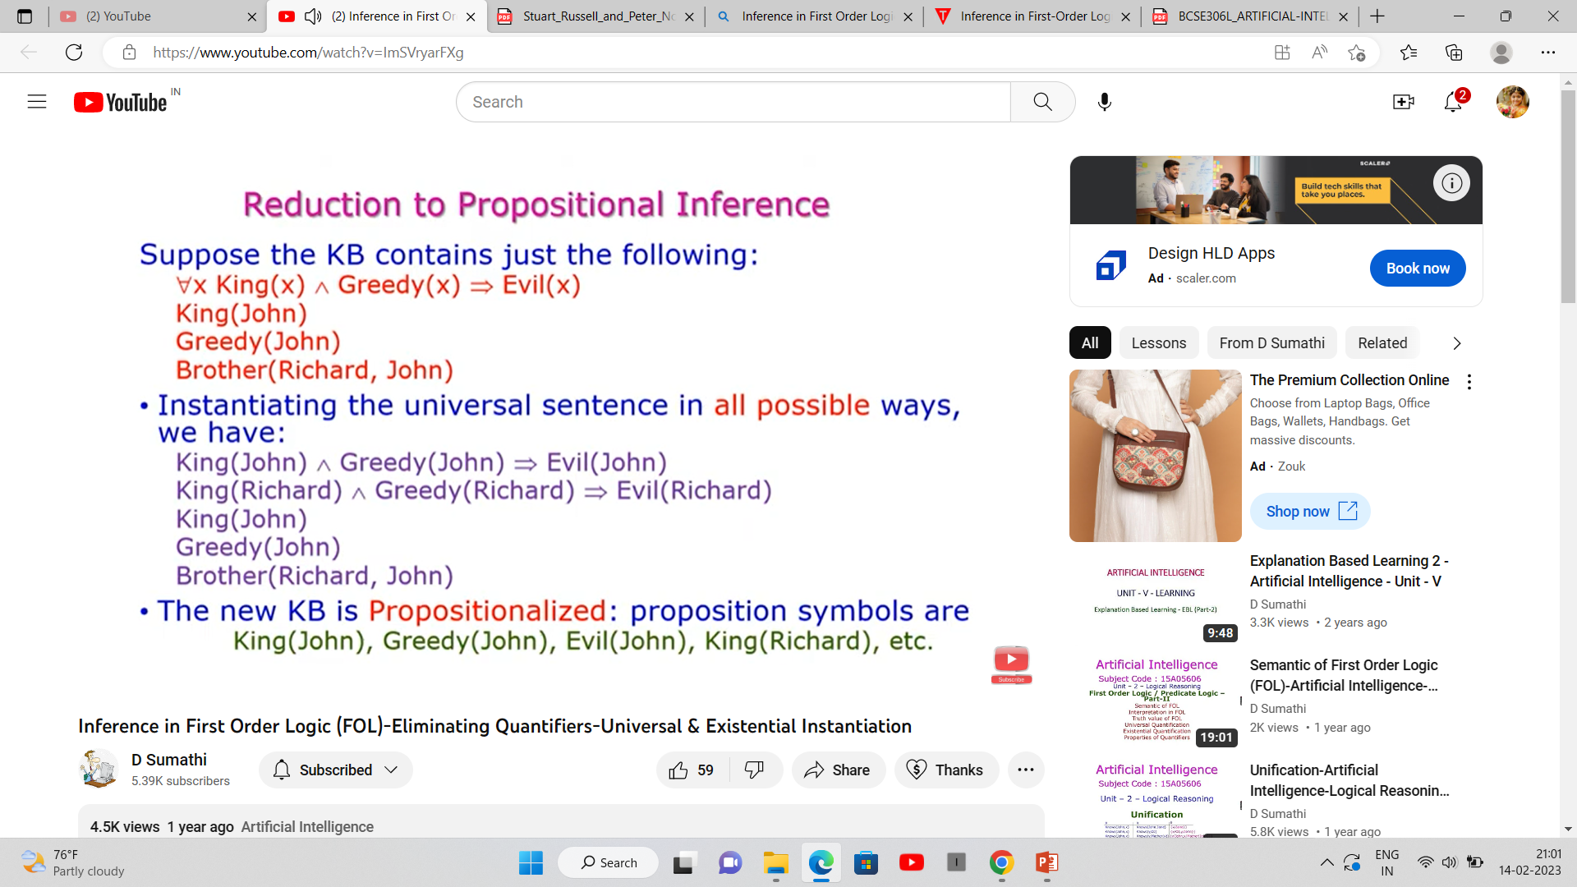

Slide 13
